Slide 2
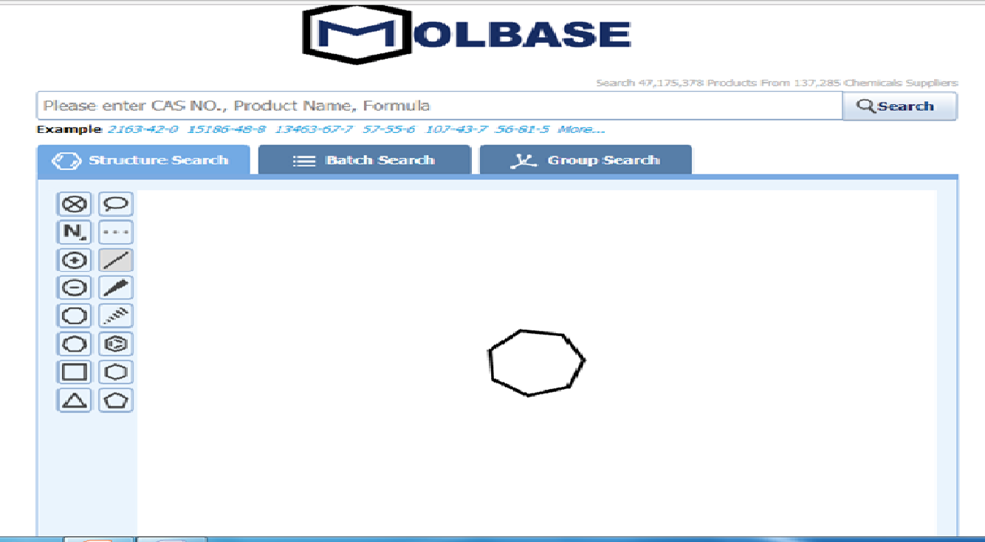

Slide 3
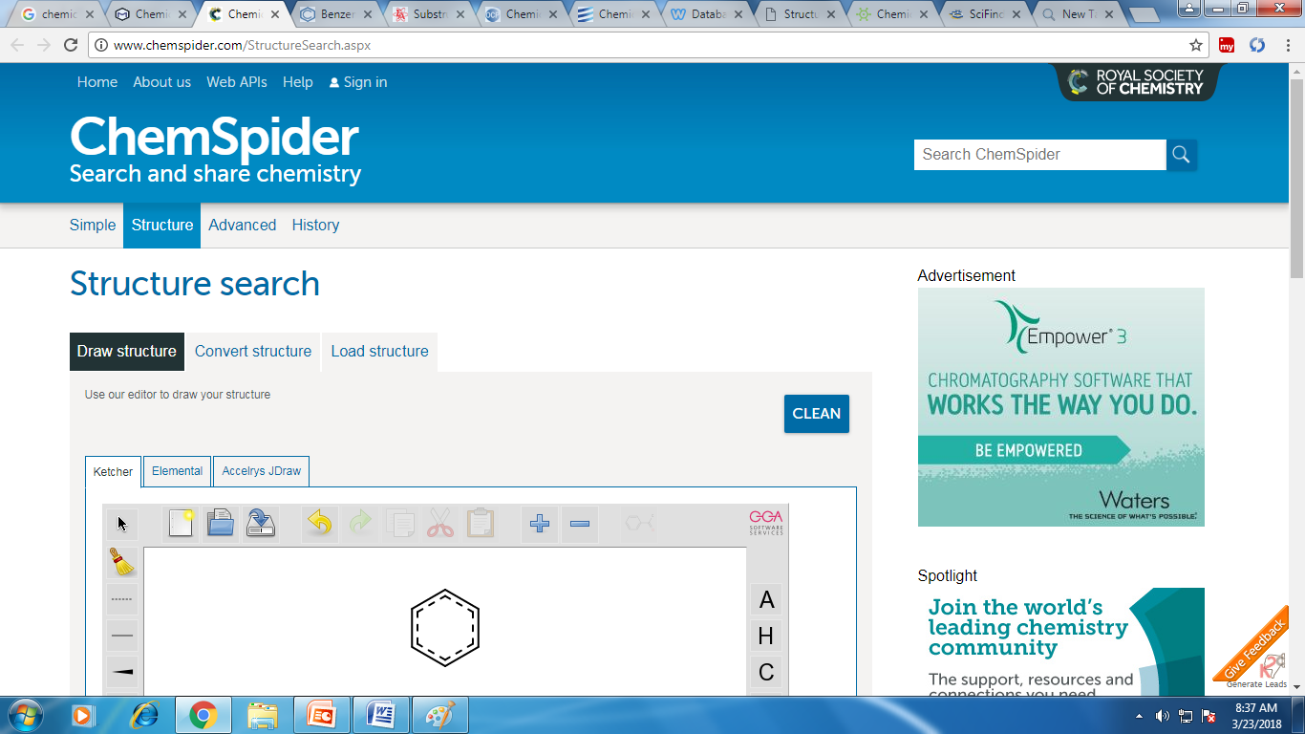

Slide 4
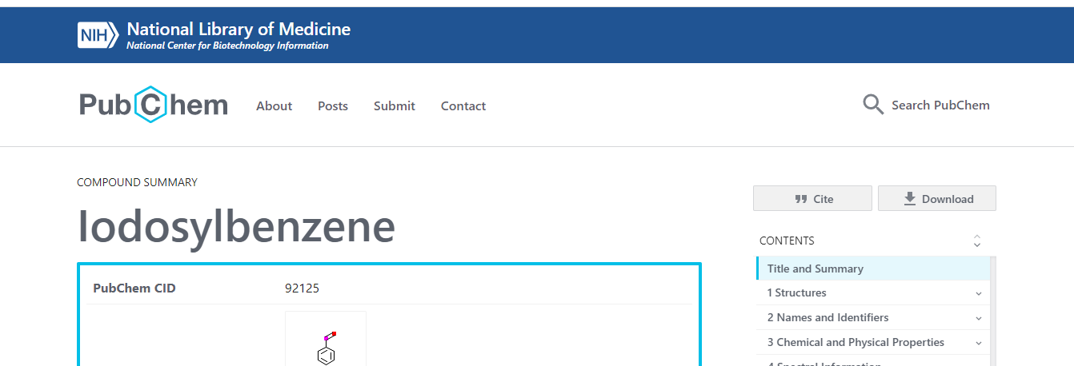
What is PubChem?
PubChem is the world's largest collection of freely accessible chemical information. Search chemicals by name, molecular formula, structure, and other identifiers. Find chemical and physical properties, biological activities, safety and toxicity information, patents, literature citations and more.

Slide 5
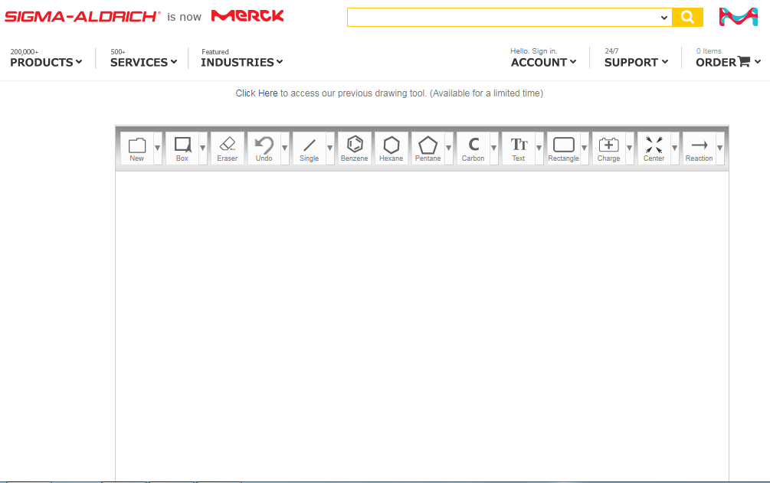

Slide 6
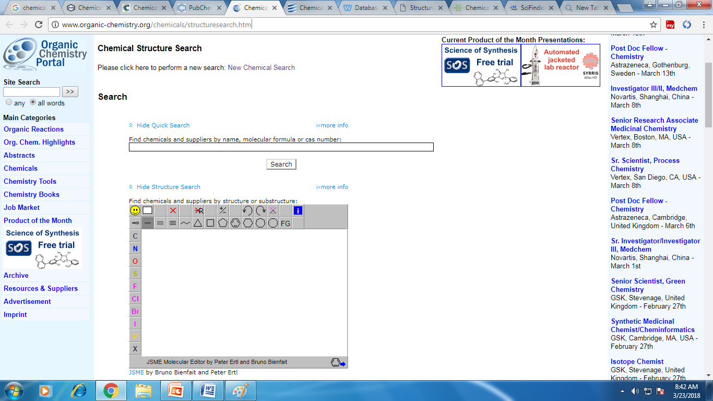

Slide 7
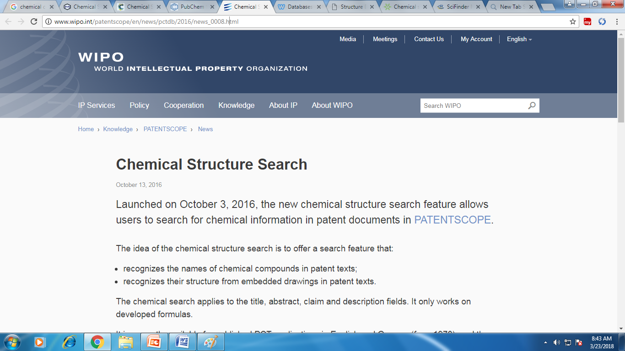

Slide 8
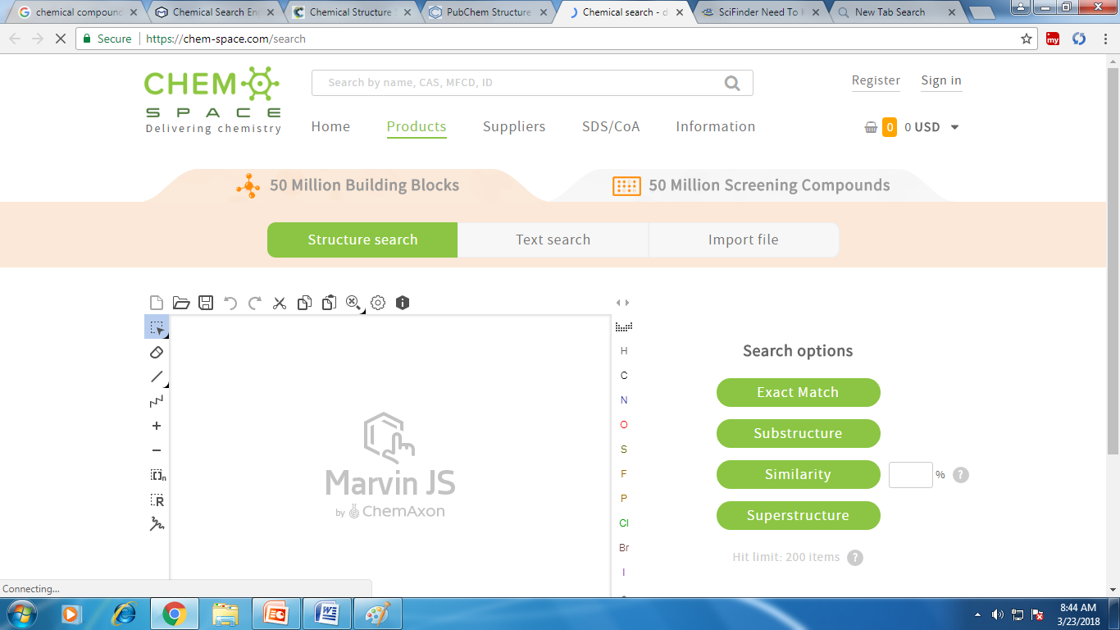

Slide 9
Canonical SMILES
The simplified molecular-input line-entry system (SMILES) is a specification in form of a line notation for describing the structure of chemical species using short ASCII strings. SMILES strings can be imported by most molecule editors for conversion back into two-dimensional drawings or three-dimensional models of the molecules.
Benzene : C1=CC=CC=C1
Bromo Benzene : BrC1=CC=CC=C1 aniline : C1=CC=C(C=C1)N benzamide : C1=CC=C(C=C1)C(=O)N

Slide 10
Chemdraw
ChemDraw is a molecule editor first developed in 1985 by David A. Evans and Stewart Rubenstein^{[1]} (later by the cheminformatics company CambridgeSoft). The company was sold to PerkinElmer in the year 2011.^{[2]} ChemDraw, along with Chem3D and ChemFinder, is part of the ChemOffice suite of programs and is available for Macintosh and Microsoft Windows.

Slide 11
Features of ChemDraw 12.0
Chemical structure to name conversion
Chemical name to structure conversion
NMR spectrum simulation (¹H and ¹³C)
Mass spectrum simulation
Structure cleanup
An extensive collection of templates, including style templates for most major chemical journals.
Export to SVG
Export to PDF (Mac Version only)

Slide 12
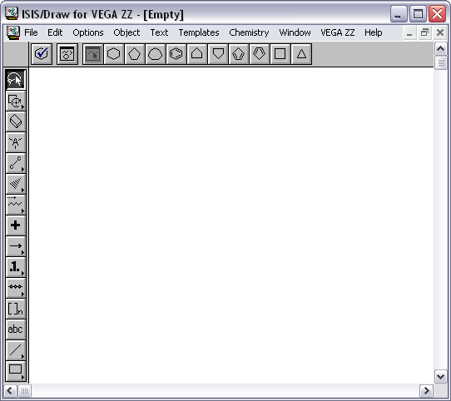

Slide 13
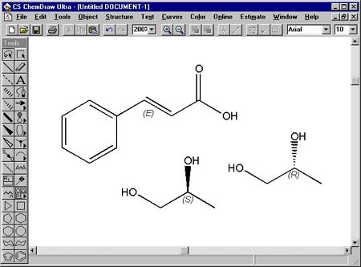
https://www.youtube.com/watch?v=00xtRYpTHaI
https://www.youtube.com/watch?v=a9r4Ofnc-Ro&pbjreload=101

Slide 14
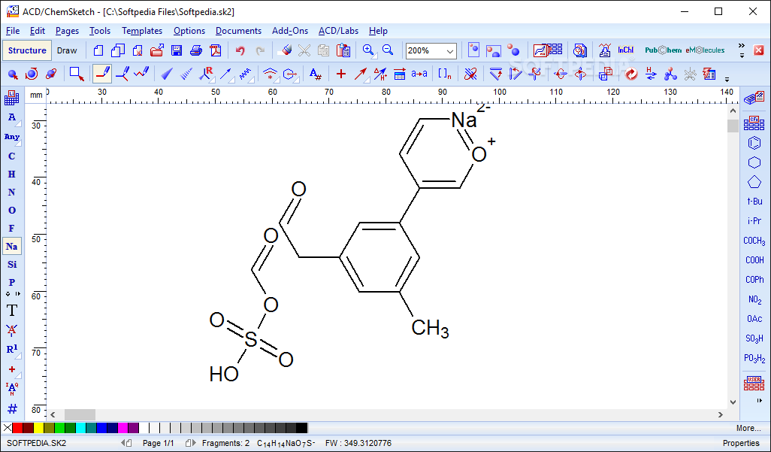

Slide 15
Chemoinformatics (cheminformatics) is a term that has been coined recently to describe a discipline organizing and coordinating the application of computers in chemistry.
The term chemoinformatics first appeared in the literature in 1998 when Brown described it as “The mixing of information resources to transform data into information, and information into knowledge, for the intended purpose of making better decisions faster in the arena of drug lead identification and optimisation.”
Chemoinformatics adopts an integrated approach to study and understand the function of chemical systems using available ligand resources such as pharmacophore modeling, quantitative structure–activity relationship (QSAR), docking, and molecular dynamics (MD) simulations.

Slide 16
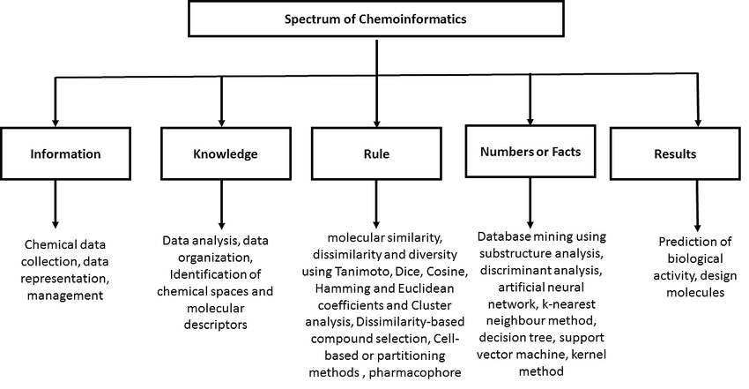

Slide 17
ChemId Plus
Substance Identification
Toxicity
Physical Properties
Structure
Molecular Weight

Slide 18
